Slide 1
Oracle Database 19c
Installation Steps

Slide 2
Link to download the Oracle 19c Database Installable
https://www.oracle.com/database/technologies/oracle19c-windows-downloads.html

Slide 3
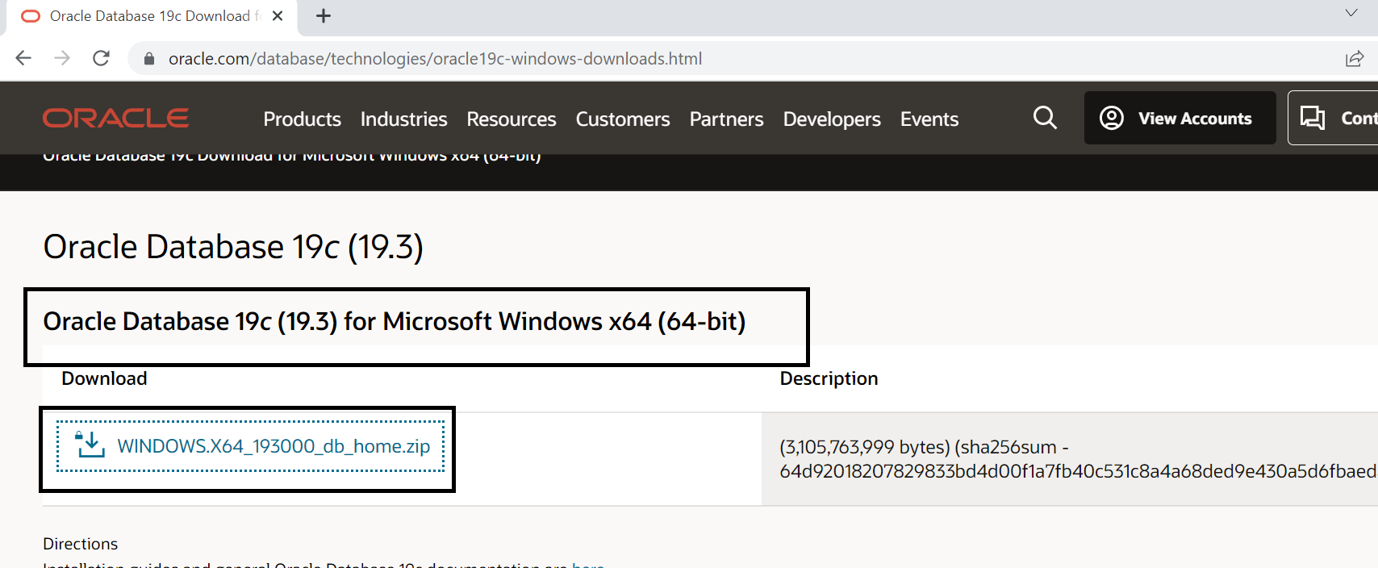
Download the selected file

Slide 4
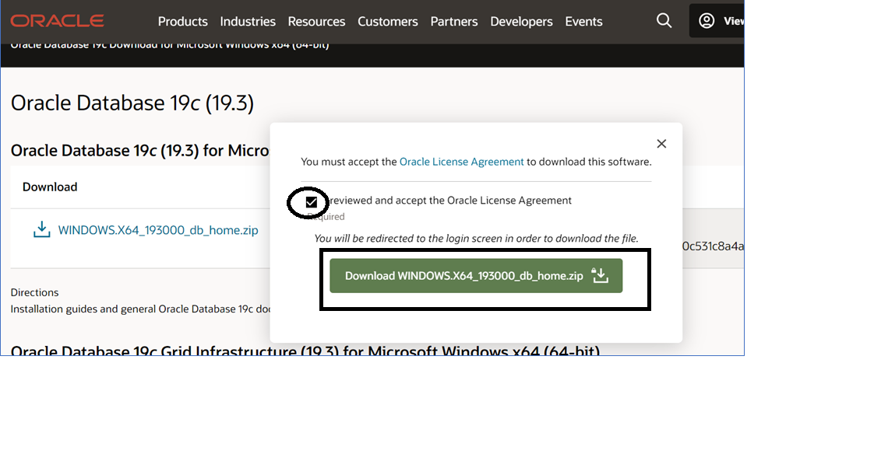

Slide 5
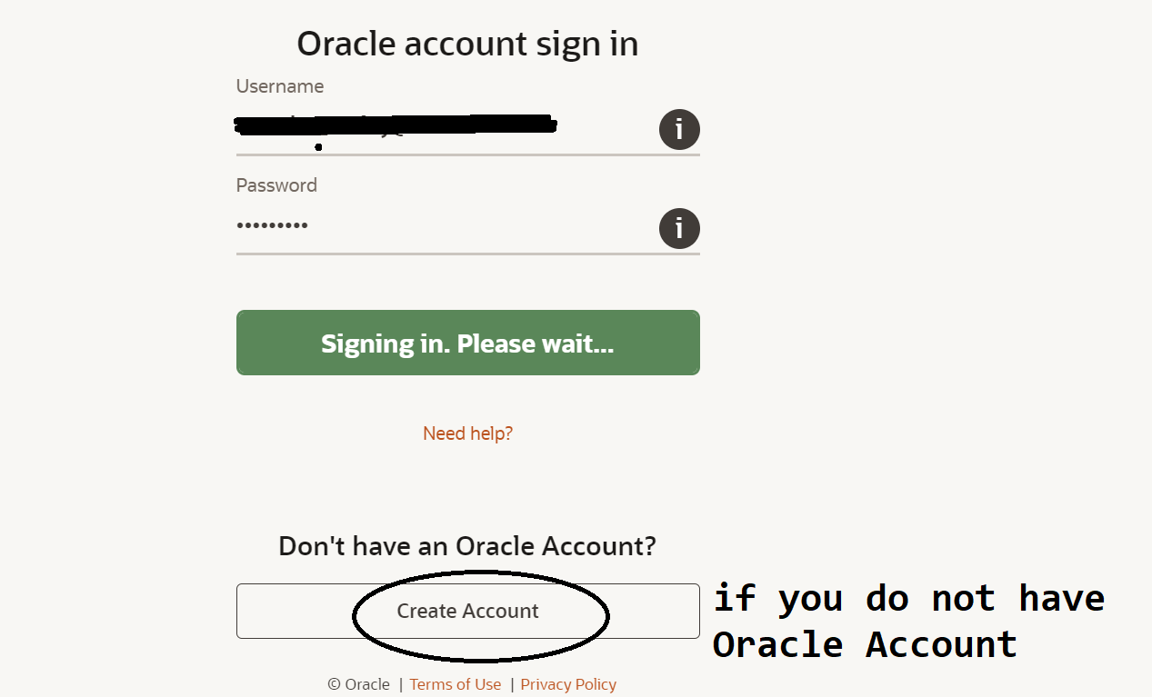
You need to create Oracle Account

Slide 6
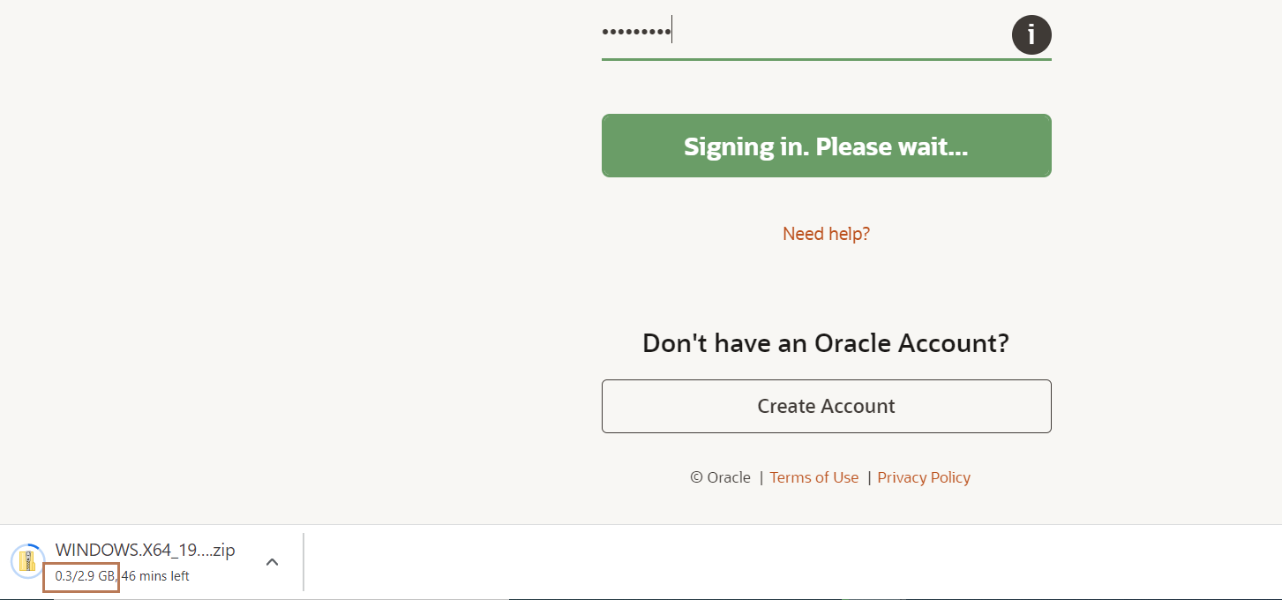
Sign with your Oracle Account Takes 30 to 40 minutes depending on Internet Speed!

Slide 7
After download is finished Extract the compressed file.
After Extracting it rename the main folder as db_home
Put that db_home folder in C drive

Slide 8
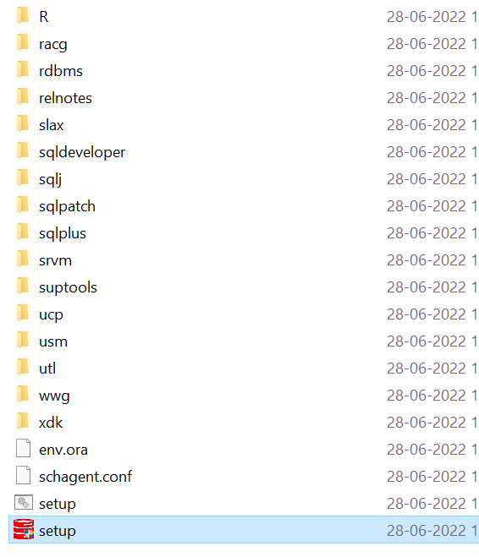
Open the db_home folder

Slide 9
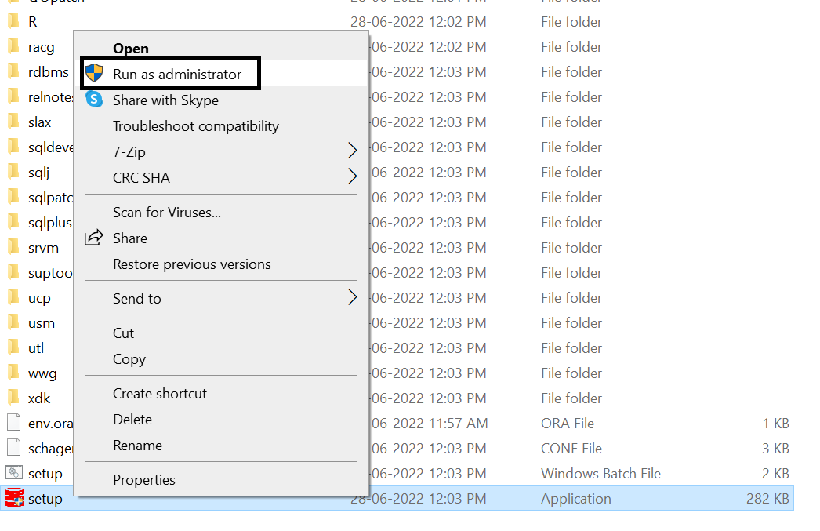
Right click on the setup file and click on Run as administrator

Slide 10
In User Account Details window click on Yes button.
Note → That screen may not come as well

Slide 11
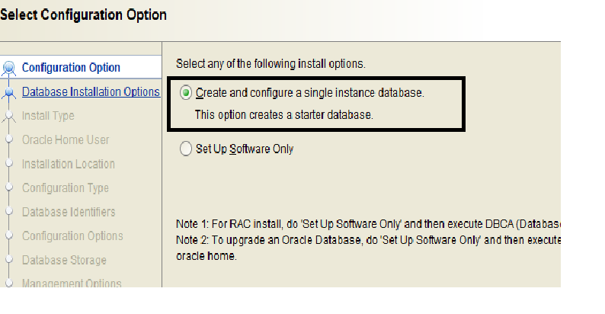

Slide 12
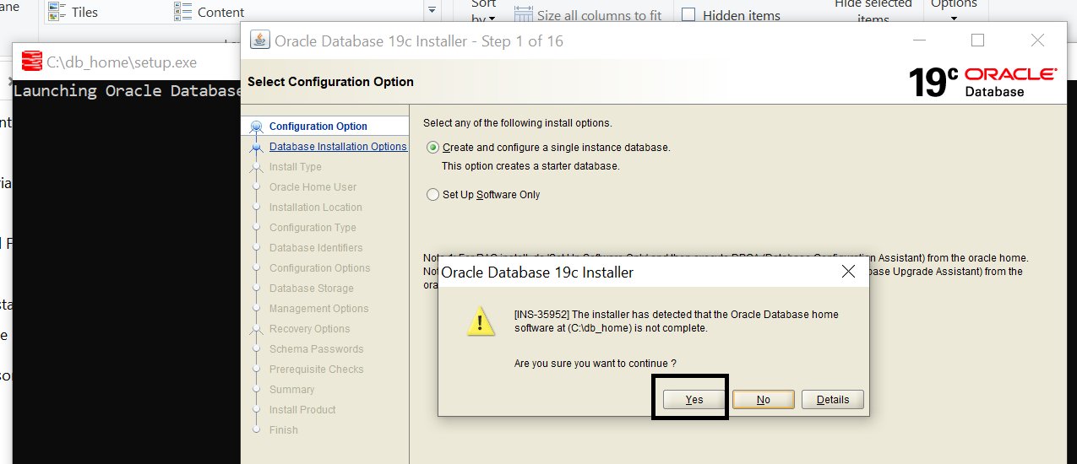
This Screen may not come. If comes then click on Yes button.

Slide 13
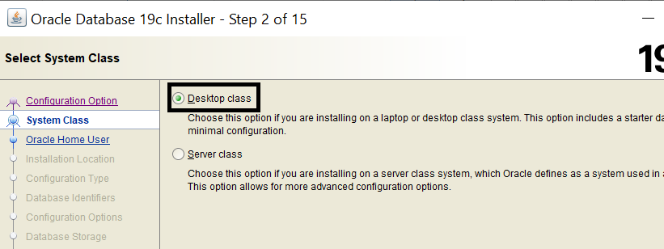

Slide 14
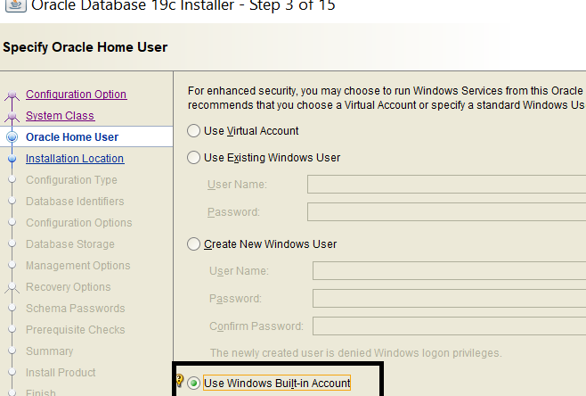
Select the 4th radio button Use Windows Built-In Account

Slide 15
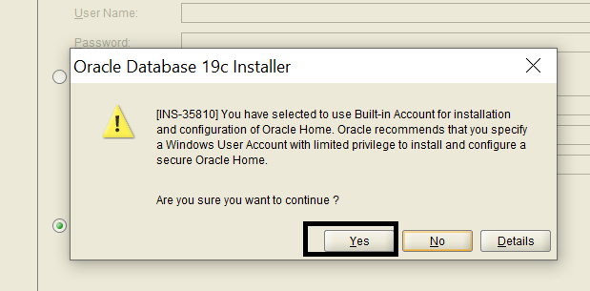

Slide 16
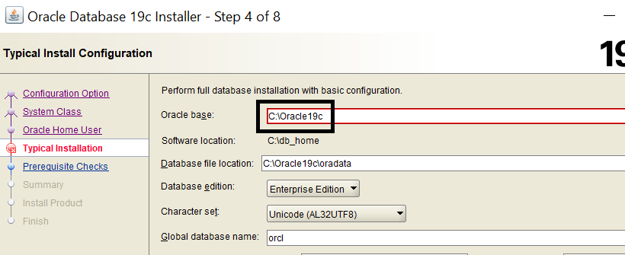
Create a folder Oracle19c in C:
In Oracle base Browse and select the path of the folder Oracle19c

Slide 17
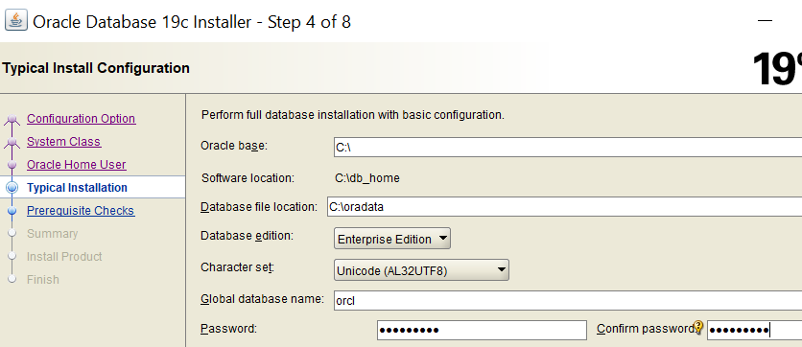
Password should be A123_b456

Slide 18
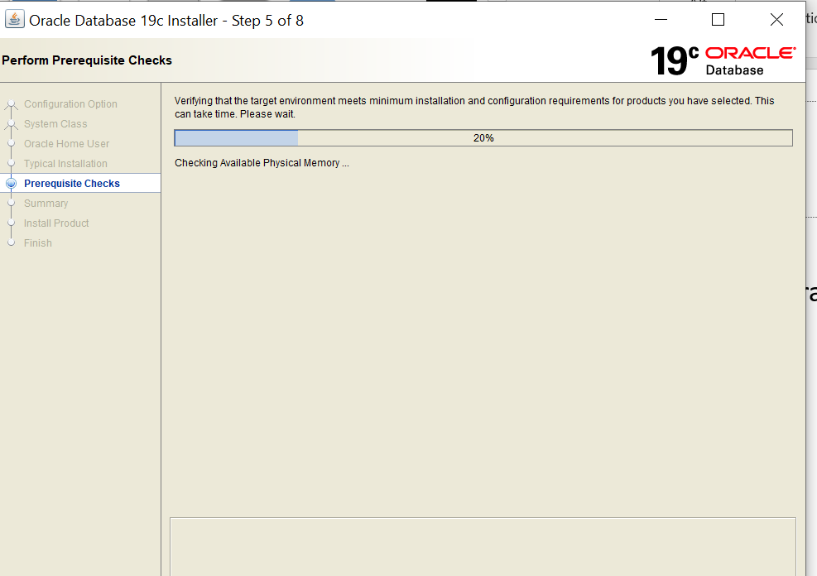

Slide 19
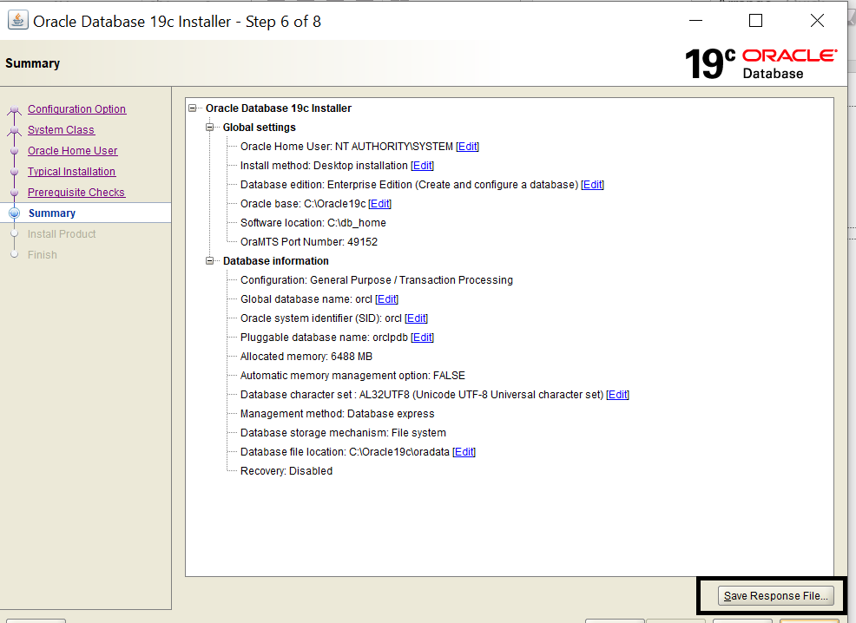

Slide 20
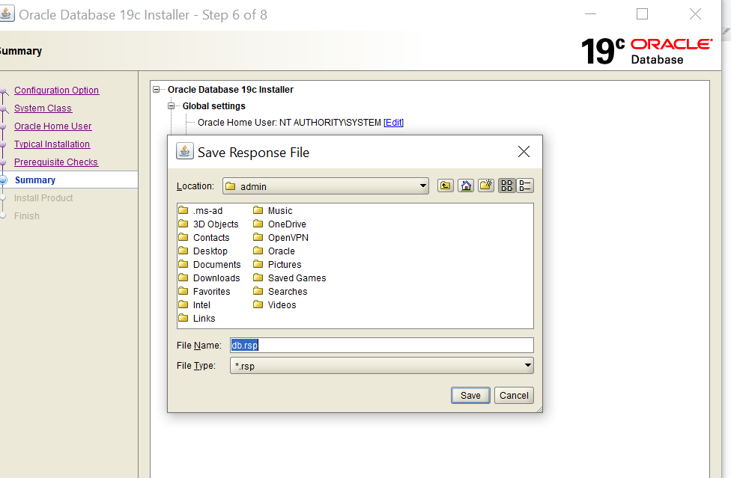
Keep the default path and default file name as db.rsp and click on Save button

Slide 21
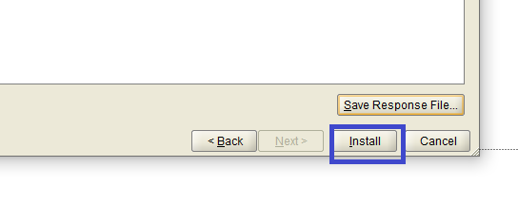
Click on the Install button

Slide 22
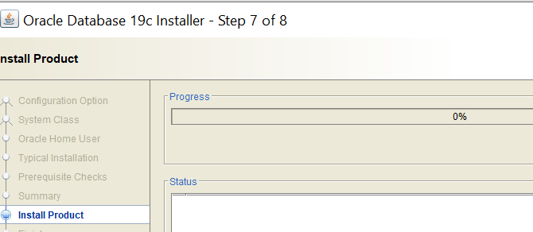

Slide 23
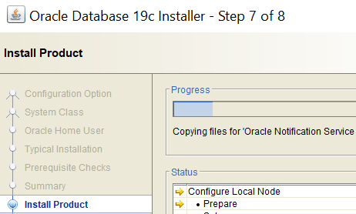

Slide 24
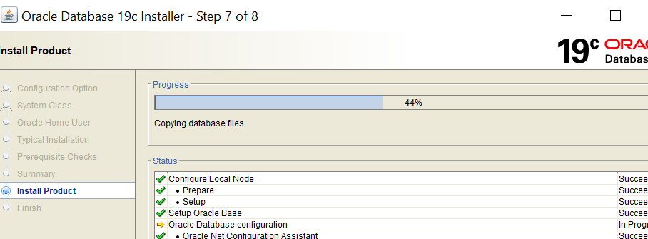

Slide 25
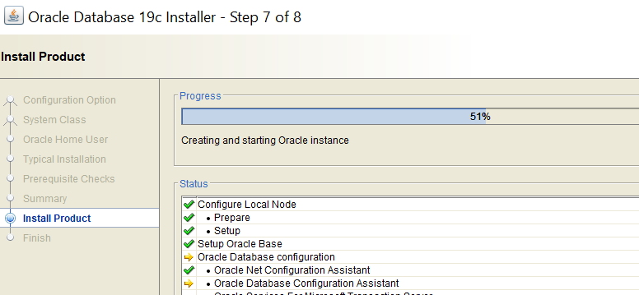

Slide 26
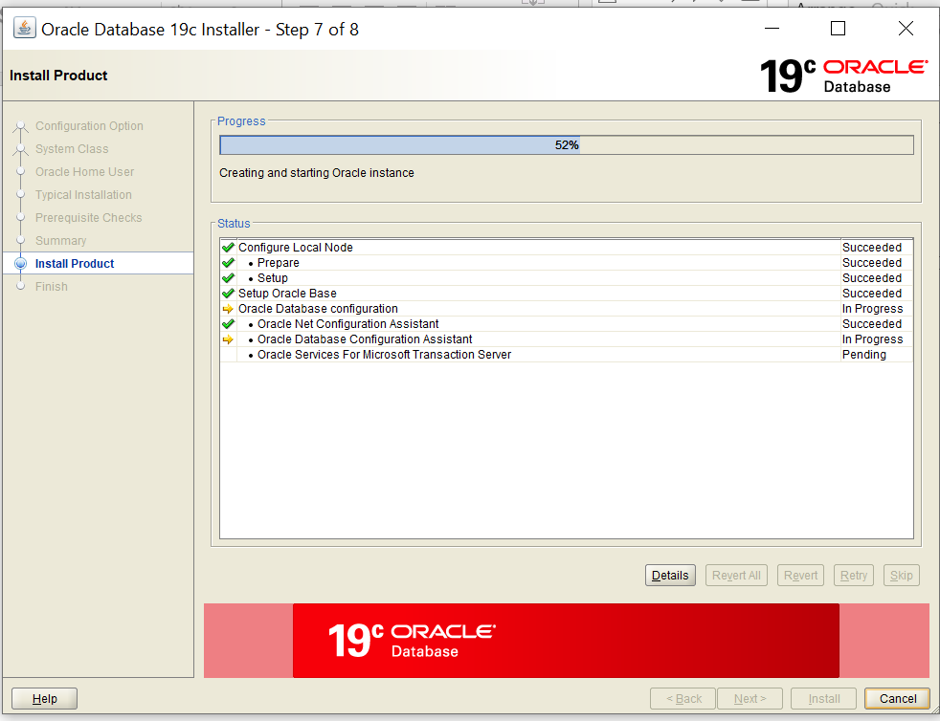
Takes more time at 52%

Slide 27
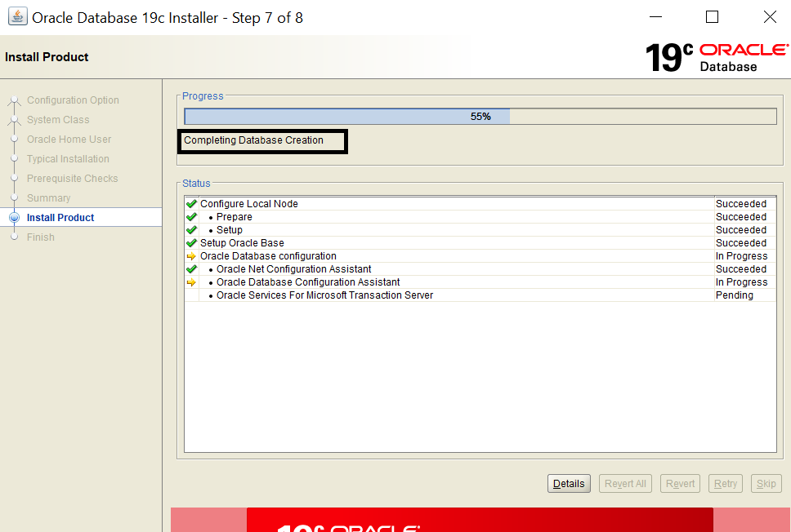

Slide 28
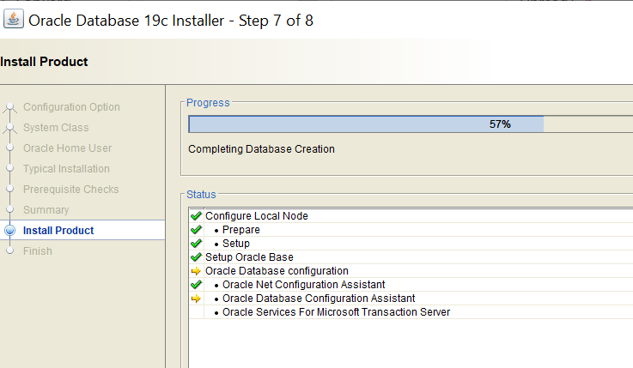
Takes more time at 57%

Slide 29
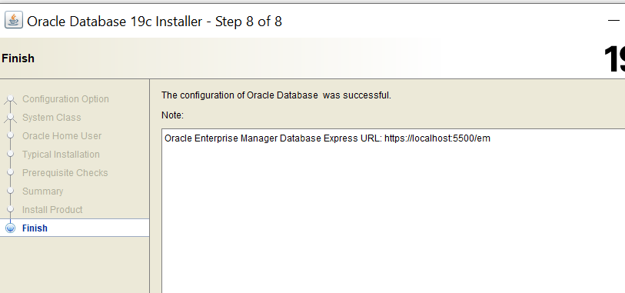
Copy-Paste the text Oracle Enterprise Manager Database Express URL: https://localhost:5500/em in a text file for future reference.

Slide 30
Click on the Close button

Slide 31
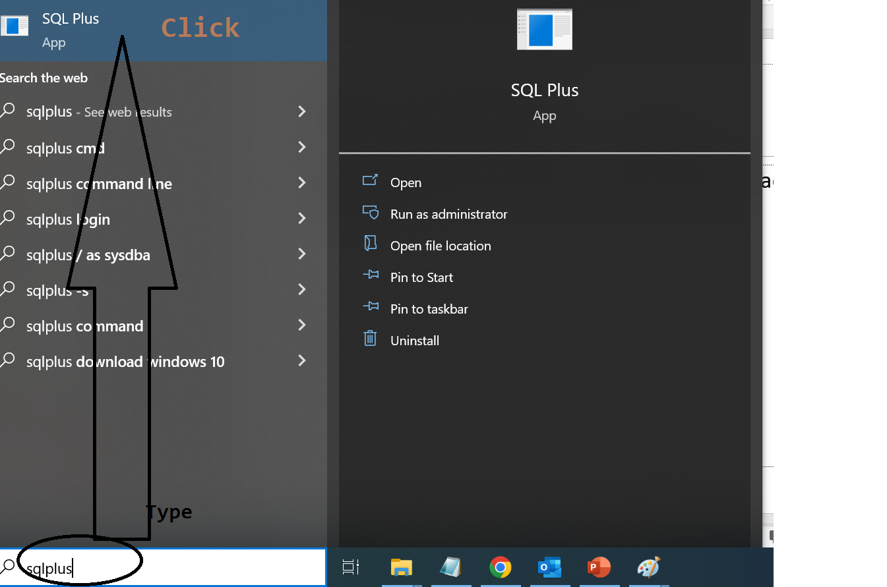
Type sqlplus in Type here to search

Slide 32
Enter user-name: conn / as sysdba
Enter password: A123_b456

Slide 33
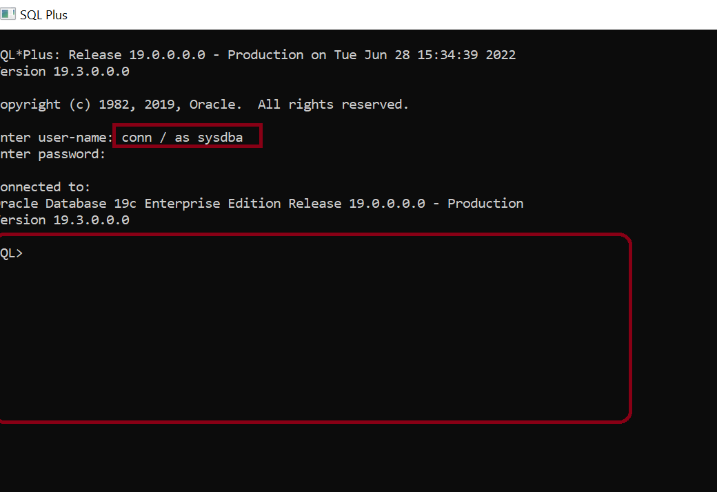

Slide 34
Type Exit and press enter on the SQL> prompt to close that SQLPlus window

Slide 35
Downloading SQL Developer Editor
https://www.oracle.com/tools/downloads/sqldev-downloads.html

Slide 36
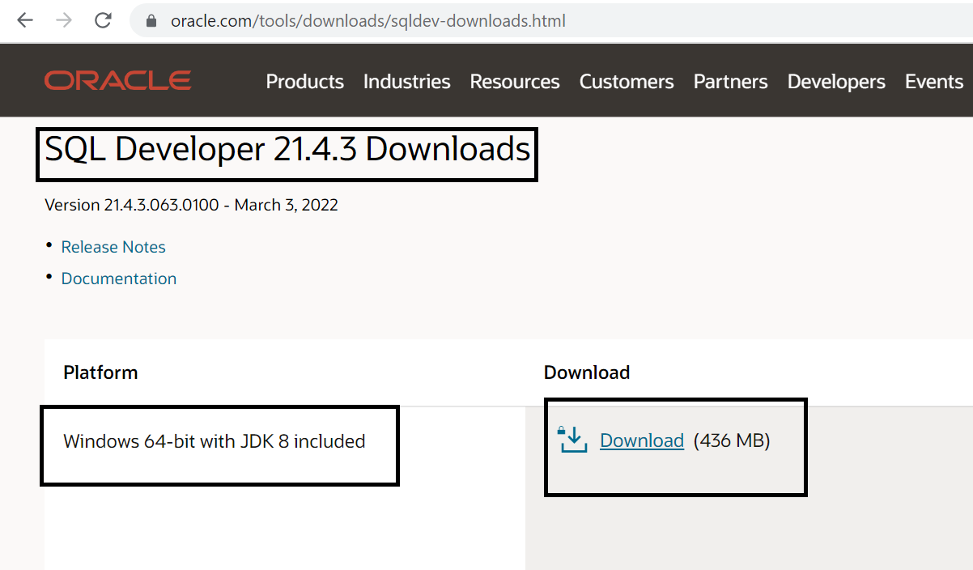
Download the selected file.

Slide 37
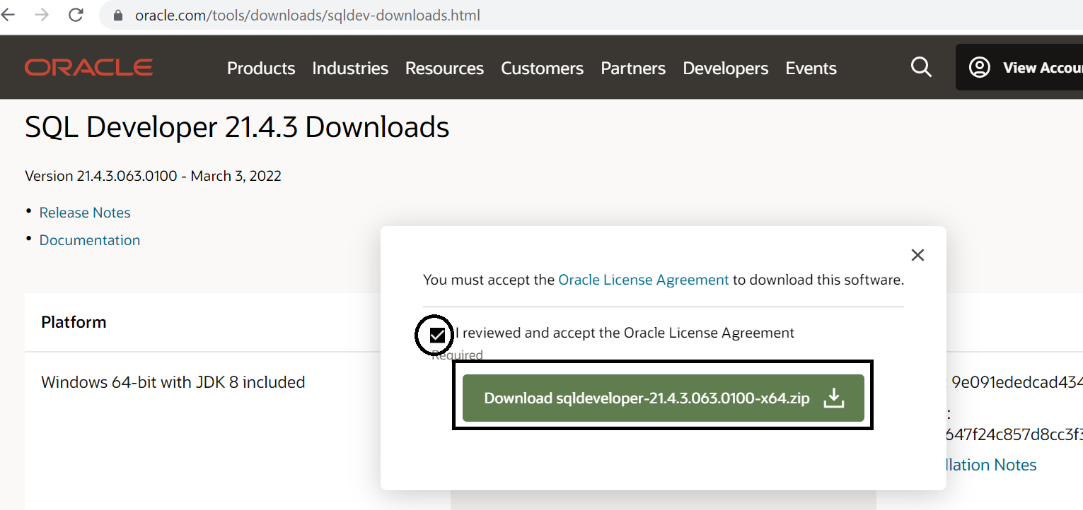

Slide 38
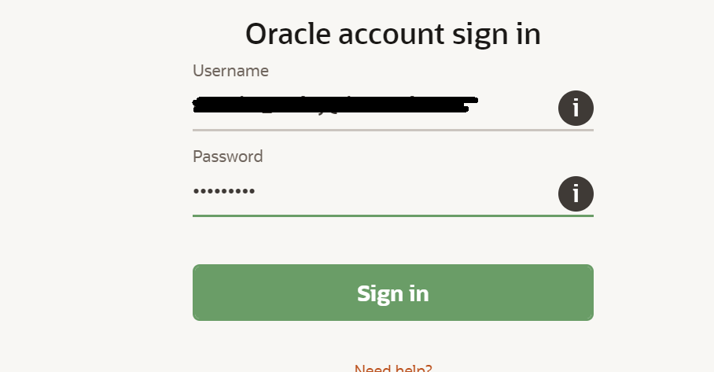
Again sign-in with your Oracle account (if required)

Slide 39
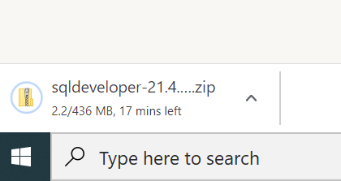

Slide 40
After downloading SQL Developer Editor copy it in C drive.
2. Extract it
3. Open the folder C:\sqldeveloper-21.4.3.063.0100-x64\sqldeveloper

Slide 41
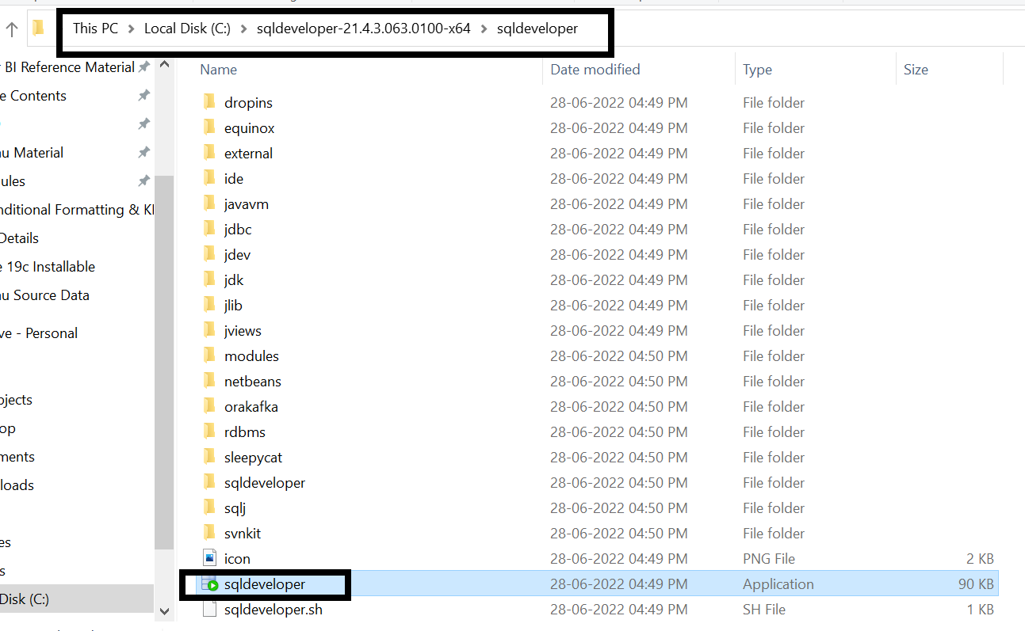
Double click on the file sqldeveloper

Slide 42
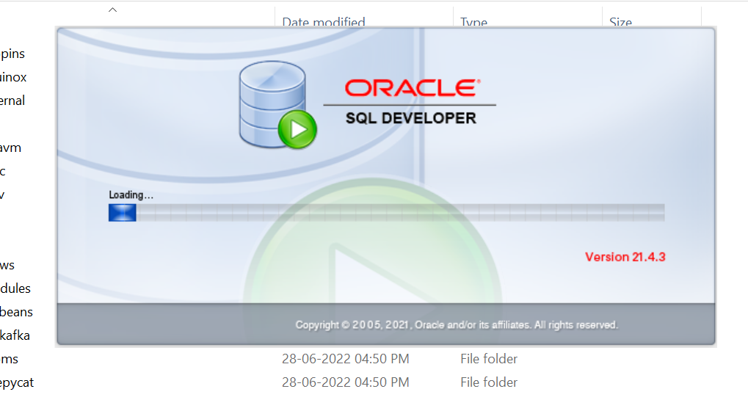

Slide 43
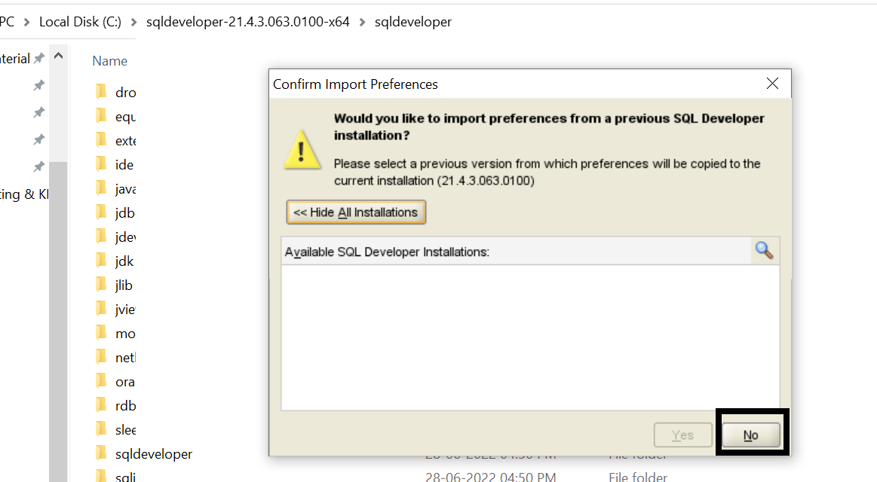

Slide 44
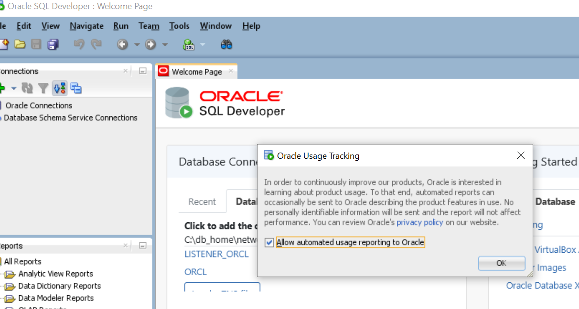

Slide 45
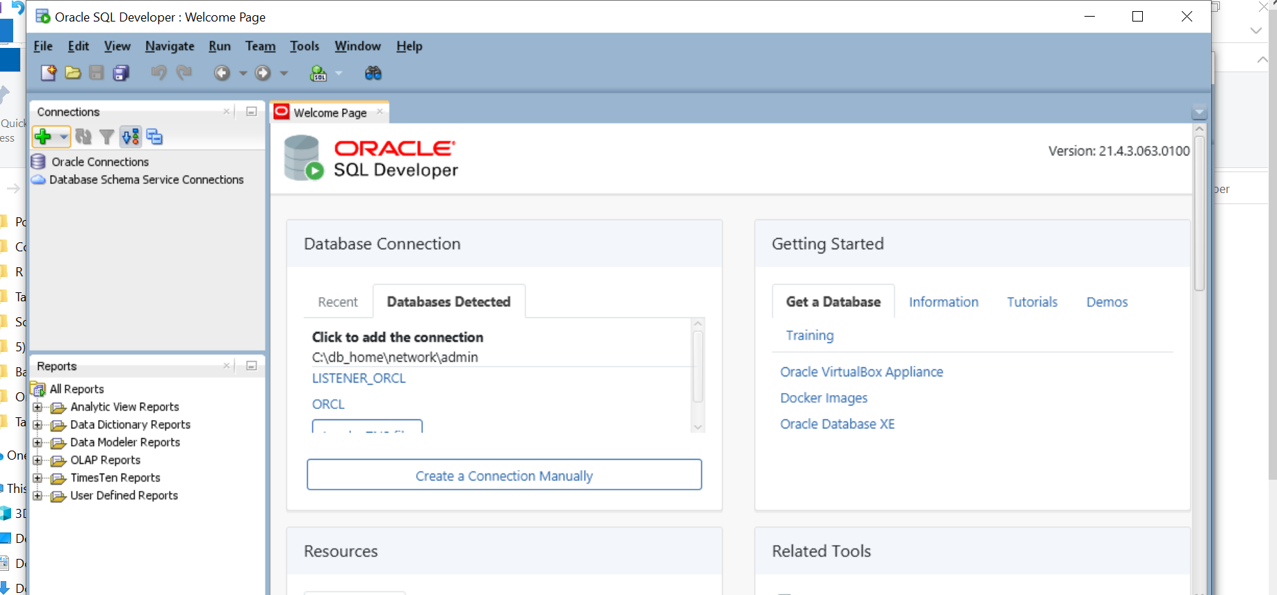
Final Screen!!!

